Slide 1

Introduction to algorithms
Homework i
Semester 1, 2021
(answer)

Slide 2
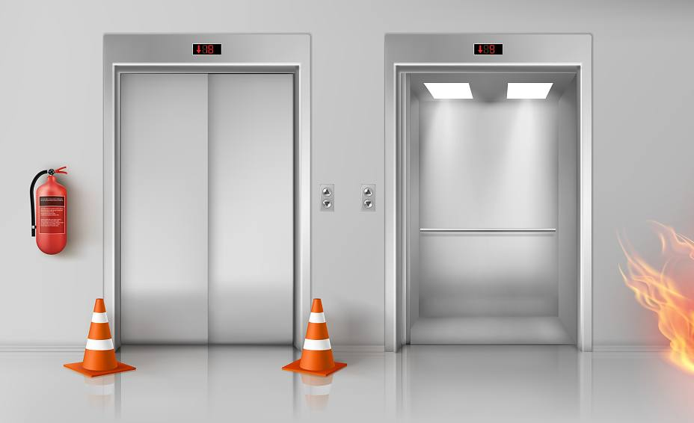
Two elevators
Imagine a tall building with n floors and two lanes of elevators E1 and E2.
Assume that a person is in level x and wants to use the elevator.
Upon pressing the elevator button, which one of
the elevator lanes (E1 or E2) should be sent to floor x?
Can you write the algorithm??
HINT: you might need to write a sub-algorithm to find the absolute value of a number. Can you say why??

Slide 3
answer
Algorithm: twoElevators(E1,E2,x)
Requires: three positive integers (elevator location and passenger floor)
Returns: the nearest elevator to be deployed to passenger at level x
Sub-function
Algorithm: abs(x)
Requires: a number (any number)
Returns: a positive number
if abs(x-E1)<abs(x-E2) then
2. return E1 //send E1, because E1 is closer to x
3. else
4. return E2
5. endif
if x<0 then
2. return -1*x
3. else
4. return x
5. endif

Slide 4
Two elevators – improved scenario
Going down uses less energy compared to moving upwards.
Assume:
going down 2 levels is equivalent to moving up 1 level
Example:
E1=6, E2=13, x=9
abs(E1-x)=3, abs(E2-x)=4
4/2=2<3
return E1 or E2 ??
Can you write the algorithm for this scenario??

Slide 5
answer
Algorithm: improvedElevators(E1,E2,x)
Requires: three positive integers (elevator location and passenger floor)
Returns: the nearest elevator to be deployed to passenger at level x with optimum energy
if (E1>=x) && (E2<=x) then
if abs(x-E1)/2 <= abs(x-E2) then
return E1
else
return E2
endif
elseif (E2>=x) && (E1<=x) then
if abs(x-E2)/2 <= abs(x-E1) then
return E2
else
return E1
endif
else
if abs(x-E1)<abs(x-E2) then
return E1
else
return E2
endif
endif
E2
E1
E2
E1
x
x
x
x
E2
E1
E1
E2

Slide 6
More work for you!
Try to add
appropriate comments
to each line in the
previous algorithm
Can you call
the first algorithm
twoElevators(E1,E2,x)
inside the improved version?

